Slide 1

Intelligent System
By: Ashok Basnet

Slide 2
My Introduction
Name : Ashok Basnet
Education : Master's In Computer System and Knowledge Engineering, Pulchowk Campus, Lalitpur
Experience :
Lecturer in NCIT College
Lecturer in Thapathali Campus
Consultant for NAXA (GIS Based Company)
Lead Various Project on Nepal Government (IMS system, Product Mapping and so on)
Paper on :
Deep learning based voice conversion network.
Nepali Text-to-Speech Synthesis using Deep Learning
Research Interest : NLP, Text to Speech and Speech to Text domain, Image processing.

Slide 3
Our Course Outline
Introduction to AI (4 hours)
Agent, Search and Game Playing (6 hours)
Pattern Recognition (5 hours)
Neural Network (5 hours)
Probabilistic Methods (5 hours)
Genetic Algorithm (5 hours)
Expert System (7 hours)
Swarm Intelligence (8 hours)

Slide 4

Introduction to AI
What is AI?
What are its related fields?
Brief history of AI
Application of AI
Definition and importance of Knowledge
Learning

Slide 5
Agent, Search and Game Playing
Black-box model of Agent
Intentionality and Goals
Game, Search, Heuristics, Pruning
Strategies Rules
Making Simple Game- Playing agents for TTT (Tic-Tac-Toe)
Evaluation Functions, Utilitarian, Decision Making, Planning, Internal Representation

Slide 6

Pattern Recognition
Classification Problems
Evaluating Classifiers
Nearest Neighbor Methods
Training, Testing and Validation
Overfitting and Complexity

Slide 7
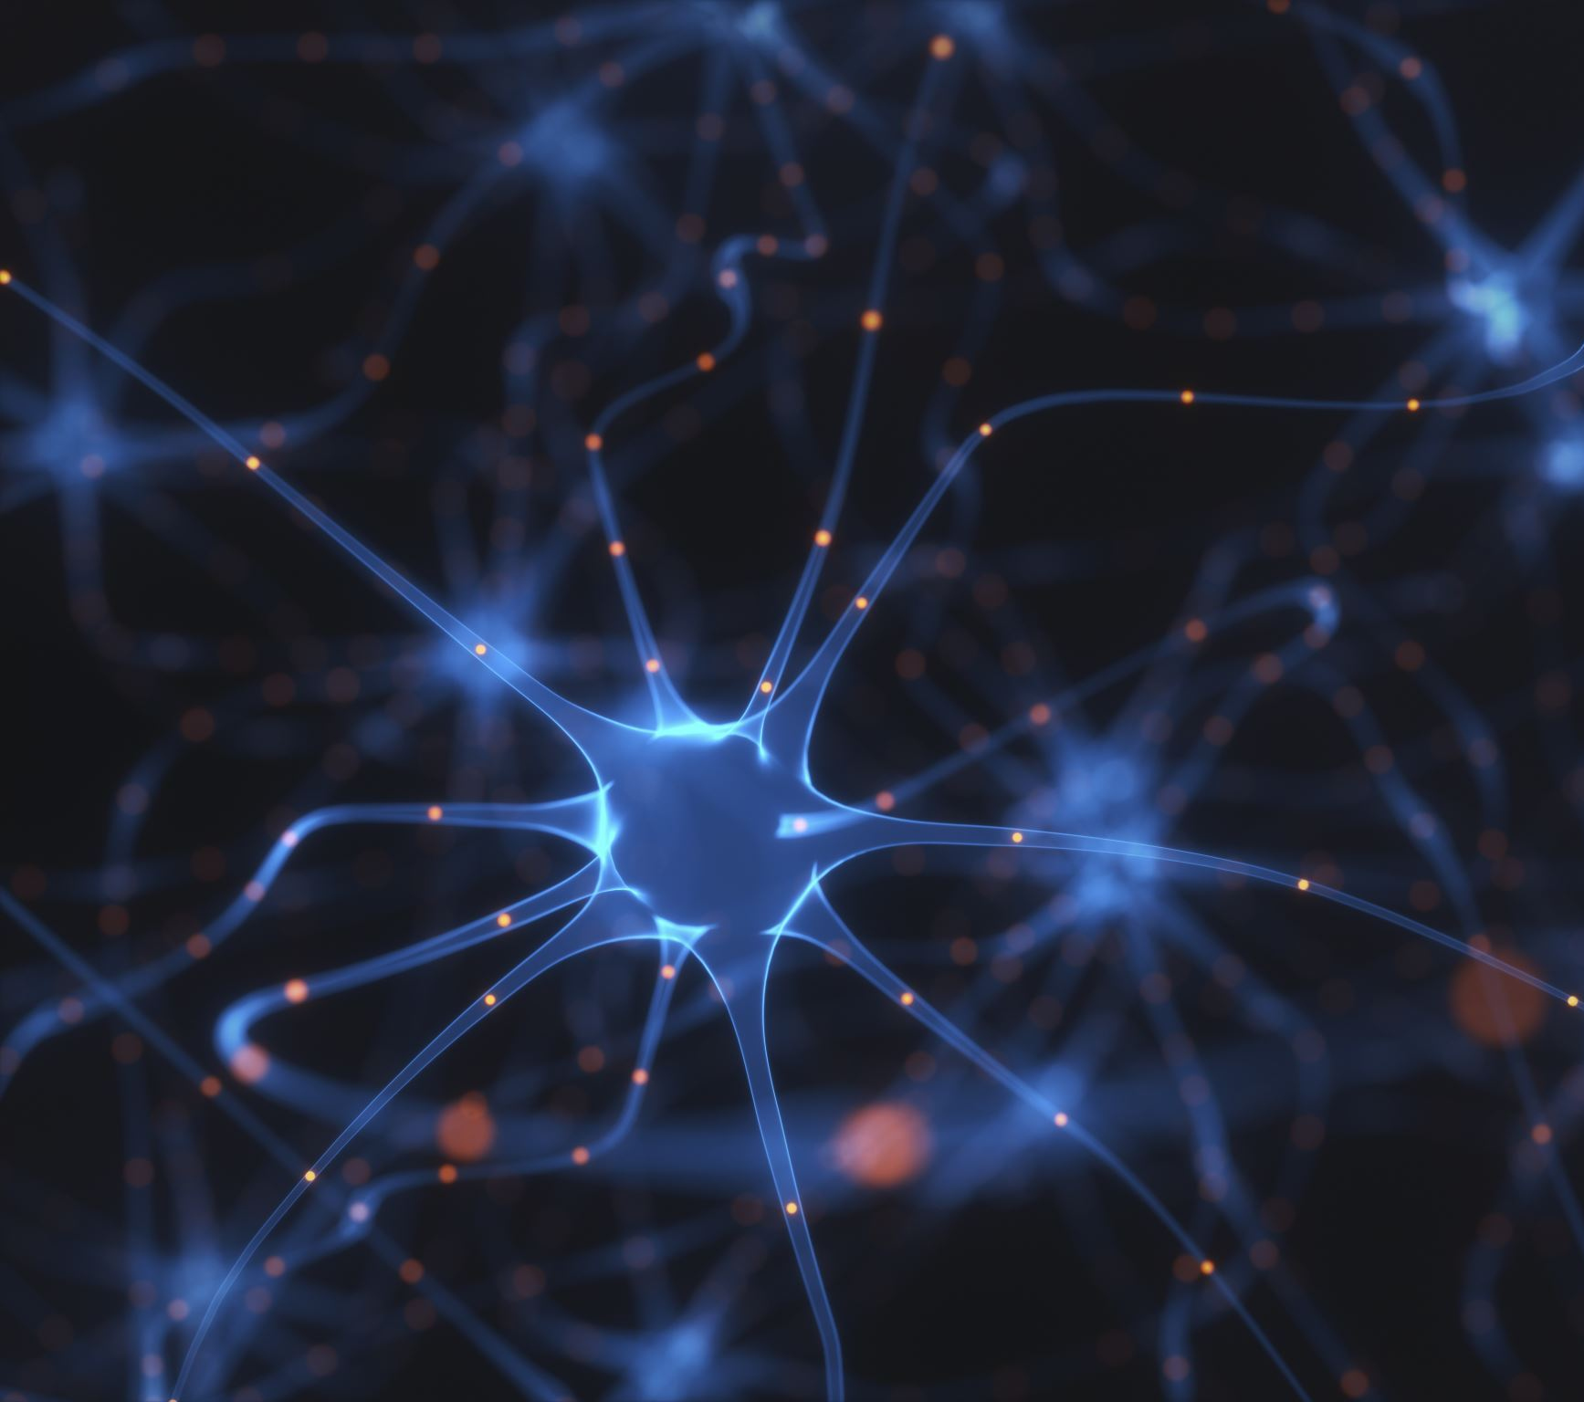
Neural Network
Biological Neural Networks
Perceptions, Multilayer and Recursive nets
Gradient Descent
Back Propagation

Slide 8
Probabilistic Methods
Introduction to Probabilistic Reasoning
Bayes and Markov Networks
Dynamic Bayesian Network (DBN's)
Hidden Markov Model (HMM's)

Slide 9

Genetic Algorithm
Introduction to Genetic Algorithm
Procedure of Genetic Algorithm
The logic behind Genetic Algorithm
Evolutionary Programming

Slide 10
Expert System
Introduction to Expert System
Features, characteristics, development and its architecture
Goals and basic activities and advantage
Stages in the development of an expert system
Probability based expert system
Expert system tools

Slide 11
Swarm Intelligence
Introduction
Background of Ant intelligent system
Importance of the Ant colony paradigm
Ant colony system
Developemnt of the Ant Colony System
Application of Ant Colony Intelligence
The working of Ant colony systems
Particle swarm intelligent system

Slide 12

Thank You

